Slide 1
Environmental taxes and Internal market in the EU : examples from the ECJ case-law on free movement and VAT harmonisation
Edoardo Traversa
Professor UCLouvain
SUSEET, Naples
22 June 2022

Slide 2
“What we are doing to the forests of the world is but a mirror reflection of what we are doing to ourselves and to one another”
“There is a sufficiency in the world for man's need but not for man's greed”
Mahatma Gandhi (1869-1948)

Slide 3
Achievement of the Internal market and EU environmental policies : collision without convergence?
Environmental taxes and EU case-law: a difficult reconciliation?
ECJ, 29 April 2004, Weigel, C-387/01 (Art. 110 TFEU- environmental car tax )
ECJ, 7 April 2011, Tatu, C-402/09 (Art. 110 TFEU – environmental car tax)
ECJ, 2 April 1998, Outukumpu, C-213/96 (Art. 110 TFEU- Excise duty on electricity)
ECJ, 7 March 2018, Cristal Union, C-31/17 (Directive 2003/96/CE)
ECJ, 16 October 2019, UPM France, C‑270/18 (Directive 2003/96/CE)
ECJ, 14 January 2021, Commission v. Italy, C‑63/19 (Directive 2003/96/CE)
Tax application of the polluter-pay principle
ECJ, Case C‑254/08, Futura Immobiliare srl Hotel Futura,
Greening the EU VAT in the internal market : a radical proposal
Past and recent developments
From hard-law to soft-law

Slide 4
Achievement of the Internal market and EU environmental policies : collision without convergence?
Internal market and taxation
Negative harmonisation :
Goods : art. 30 and 110 TFEU
Services, Persons and Capital
Positive harmonisation
Art. 113 TFEU : indirect taxes (VAT, excises duties, …)
Art. 115 TFEU : other taxes (CIT directives, exchange of information, …)
Environmental objectives
Art. 11 TFEU : “Environmental protection requirements must be integrated into the definition and implementation of the Union's policies and activities, in particular with a view to promoting sustainable development.”

Slide 5
Environmental taxes and EU case-law: a difficult reconciliation?

Slide 6
ECJ, 7 April 2011, Tatu, C-402/09
Environment objective as a fake justification
“Moreover, it is clear, as Mr Tatu rightly observes, that the objective of protection of the environment put forward by the Romanian Government, taking the form of preventing, by the application of a deterrent tax, the use in Romania of particularly polluting vehicles, such as those corresponding to standards Euro 1 and Euro 2 with a large cylinder capacity, and using the revenue from that tax to finance environmental projects, could be achieved more completely and consistently by imposing the pollution tax on all vehicles of that kind in circulation in Romania. Such a tax, whose implementation in connection with an annual road tax is entirely conceivable, would not favour the domestic second-hand vehicle market over the placing in circulation of imported second-hand vehicles, and would moreover be consistent with the polluter-pays principle.”

Slide 7
ECJ, 2 April 1998, Outukumpu, C-213/96

Slide 8
ECJ, 2 April 1998, Outukumpu, C-213/96
31. Article 95 of the Treaty therefore does not preclude the rate of an internal tax on electricity from varying according to the manner in which the electricity is produced and the raw materials used for its production, in so far as that differentiation is based, as is clear from the actual wording of the national court's questions, on environmental considerations.
32. As the Court stated in Case 302/86 Commission v Denmark [1988] ECR 4607,paragraph 8, protection of the environment constitutes one of the essential objectives of the Community. Moreover, since the entry into force of the Treaty onEuropean Union, the Community's task includes the promotion of sustainable and non-inflationary growth respecting the environment (Article 2 of the EC Treaty)and its activities include a policy in the sphere of the environment (Article 3(k) ofthe EC Treaty).
33. Furthermore, as the Advocate General observes in paragraph 58 of the Opinion, compatibility with the environment, particularly of methods of producing electricalenergy, is an important objective of the Community's energy policy.
34. However, on the question whether differentiation such as that which characterizes the tax system at issue in the main proceedings is compatible with the prohibition of discrimination in Article 95 of the Treaty, the Court has consistently held that that provision is infringed where the taxation on the imported product and that onthe similar domestic product are calculated in a different manner on the basis ofdifferent criteria which lead, if only in certain cases, to higher taxation being imposed on the imported product (see, in particular, Case C-152/89 Commissionv Luxembourg [1991] ECR I-3141, paragraph 20).
35. That is the case where, under a system of differential taxation of the kind at issue in the main proceedings, imported electricity distributed via the national network is subject, whatever its method of production, to a flat-rate duty which is higher than the lowest duty charged on electricity of domestic origin distributed via the national network.

Slide 9
ECJ, 7 March 2018, Cristal Union, C-31/17
Article 1 of Directive 2003/96 provides that the Member States are to impose taxation on energy products and electricity in accordance with that directive.
Under Article 14(1)(a) of that directive:
‘In addition to the general provisions set out in [Council] Directive 92/12/EEC [of 25 February 1992 on the general arrangements for products subject to excise duty and on the holding, movement and monitoring of such products (OJ 1992 L 76, p. 1)] on exempt uses of taxable products, and without prejudice to other Community provisions, Member States shall exempt the following from taxation under conditions which they shall lay down for the purpose of ensuring the correct and straightforward application of such exemptions and of preventing any evasion, avoidance or abuse:
(a) energy products and electricity used to produce electricity and electricity used to maintain the ability to produce electricity. However, Member States may, for reasons of environmental policy, subject these products to taxation without having to respect the minimum levels of taxation laid down in this Directive. In such case, the taxation of these products shall not be taken into account for the purpose of satisfying the minimum level of taxation on electricity laid down in Article 10.’
Article 15(1)(c) of that directive provides:
‘1. Without prejudice to other Community provisions, Member States may apply under fiscal control total or partial exemptions or reductions in the level of taxation to:
(c) energy products and electricity used for combined heat and power generation’.

Slide 10
ECJ, 7 March 2018, Cristal Union, C-31/17
34 Moreover, it should be recalled that Directive 2003/96 also seeks to achieve the objective, as stated in recitals 6, 7, 11 and 12 thereof, of promoting environmental-policy objectives (judgment of 7 September 2017, Hüttenwerke Krupp Mannesmann, C‑465/15, EU:C:2017:640, paragraph 26).
35 However, the taxation of energy products when used for the generation of electricity by a cogeneration unit, such as that at issue in the main proceedings, would, in view of the risk of double taxation which it involves, run counter to that objective.
36 EU law seeks, as is apparent from, in particular, Directive 2012/27/EU of the European Parliament and of the Council of 25 October 2012 on energy efficiency, amending Directives 2009/125/EC and 2010/30/EU and repealing Directives 2004/8/EC and 2006/32/EC (OJ 2012 L 315, p. 1), to promote cogeneration on the basis of a useful heat demand in the internal energy market, since high-efficiency cogeneration offers significant potential for saving primary energy.
37 Furthermore, it is common ground that, as is apparent from recital 20 of Directive 2003/87/EC of the European Parliament and of the Council of 13 October 2003 establishing a scheme for greenhouse gas emission allowance trading within the Community and amending Council Directive 96/61/EC (OJ 2003 L 275, p. 32), cogeneration gives rise to fewer CO2 emissions per unit of output than the separate production of heat and electricity.
38 Accordingly, it must be held that it is clear, both from the wording of the first sentence of Article 14(1)(a) of Directive 2003/96 and from the general scheme and purpose of that directive, that energy products used for combined heat and electricity generation come within the scope of application of the compulsory exemption provided for in that provision.

Slide 11
Environmental taxes and EU VAT harmonisation: an even more difficult reconciliation?

Slide 12
Achievement of the Internal market and EU environmental policies : collision without convergence?
Evolution at the legislative level
Council Directive 75/442/EEC of 15 July 1975 on waste, adopted on the basis of article 100 of the Treaty of Rome
Directive 2008/98/EC of the European Parliament and of the Council of 19 November 2008 on waste and repealing certain Directives, adopted on the basis of article 192 [ex-175] TFEU
Is it imaginable for the value-added tax?

Slide 13
“Green VAT is no good for EU” : really?

Slide 14
I. Basic features of VAT
II. Quantification of the Environmental footprint of products
III. Potential application of LCA in taxation
IV. Adapting EU VAT to LCA

Slide 15
I. Basic principles of VAT
Generality
Applicable to the whole value-chain
Neutrality
Application to all products
Proportionality
Rate applied to tha taxable base (= value/price of the product/service)
Reduced rates
Deduction
No charge for business
Distinction with excises
Target only specific products
Double rate : Ad valorem v. specific rate
No deduction (but repercussion)

Slide 16
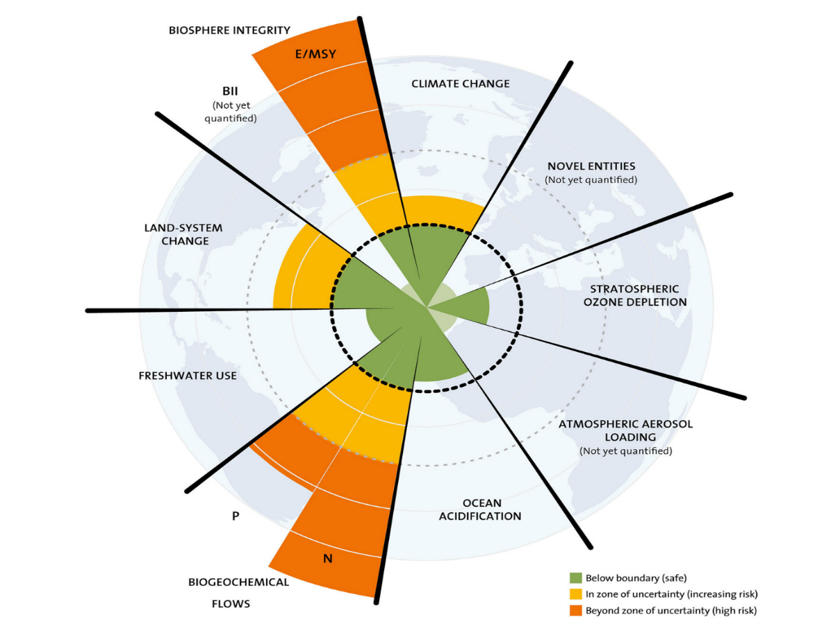
II. Quantification of the Environmental footprint of products : the context
“new research reveals major benefits of integrated approaches to climate and nature” (UNEP 2020)
“need to address multiple interacting environmental processes simultaneously” (Steffen et al. 2015)
“all actions under the Green Deal should have a science-based approach and be based on holistic impact assessments” (European Parliament 2020)
“in fact, the Sustainable Development Goals are regarded as ‘integrated and indivisible’, balancing the economic, social and environmental dimensions of sustainable development” (IPBES 2019)
(Steffen et al. 2015)

Slide 17
II. Quantification of the Environmental footprint of products through life-cycle analysis
“To reach the UN sustainable development goal, there is a need for comprehensive and robust tools to help decision-making identify the solutions that best support sustainable development. The decisions must have a system perspective, consider the life cycle, and all relevant impacts caused by the solution. Life Cycle Assessment (LCA) is a tool that has these characteristics”(Hauschild et al., 2018)
“LCAs provide the best framework for assessing the potential environmental impacts of products currently available” (European Commission 2003)
“LCA is widely recognized as the best framework for assessing the potential environmental impacts of products, process and systems” (Joint Research Centre, 2016)
➔ Product Environmental Footprint project:
-increases comparability of environmental impacts of products
-decreases flexibility of LCA to ensure reproducibility of results
Eco-score: LCA scores of 2500 product categories drawn from the Agribalyse database
Global LCA Data Access” network (GLAD) https://www.lifecycleinitiative.org/

Slide 18
II. Translation of Life-cycle analysis in pricing : state of the art
Several methods for monetising LCA results
➔ No consensus on the best method
Methods for monetising LCA results | Monetary damage assessment criteria | Price per tonne equivalent-CO₂ in euros
Ecovalue14 | Stated preferences, market prices | 480
EPS | Revealed preferences, market prices | 137
EVR 1.6 | Pollution abatement costs | 119
Stepwise 2006 | Budget constraint | 107
MMG | Restoration costs | 106
Ecotax 2002 | Social willingness to pay | 62
Environmental Prices | Pollution abatement costs | 59
LIME3 | Revealed preferences | 7
(Arendt et al. 2020)

Slide 19
II. Translation of Life-cycle analysis in pricing : a weighting issue
Monetisation methods are weighting methods
➔ When the normalisation and weighting values are set, pricing one of the impact categories means pricing the other categories

Slide 20
III. Translation of Life-cycle analysis in indirect taxation : models
Proposals to use LCA for taxation purposes
- De Camillis & Goralczyk 2012 : comparing the LCA scores of the products and adapting their ad valorem rates accordingly
- Timmermans & Achten 2018; Moberg et al. 2018 : no comparative target. The LCA score is added as an excise duty
Significant potential revenues
-The case of Sweden (Ecotax 2002, Arendt et al. 2020): 5400 € VAT; 240 € Carbon tax; 7900 € LCA-based tax (per pers. per yr.)
-Simulation on 45 countries:

Slide 21
IV. Adapting EU VAT to LCA
Traditional VAT rate policy is not the most adequate instrument
The price does not reflect the ecological footprint
Similar products may have different ecological footprints
Reduced rates are ineffective
Two-pronged general consumption tax (double rate)
Traditional VAT (based on current framework)
Standard rate would be progressively reduced to create some room
Global damage Tax (GDT)
LCA score (per unit) X coefficient (in €)
=> increase in time (with prior announcement so that consumers and undertakings may adapt their behavior)
access to a centralized database
Excise would remain as specific taxes in consumption
Adaptation would be needed
Compensation/redistribution measures should be taken to mitigate social impact

Slide 22
How the DaVAT works – example of jeans (with a rate of 20%) – YEAR 1
20% +
0.04 €
collected by the intermediary
paid back by the State to the intermediary buyer
20% +
0.05 €
collected by the intermediary
paid back by the State to the intermediary buyer
collected by the intermediary
(entirely paid by the end-user)
20% +
0.06 €

Slide 23
How the DaVAT works – example of jeans (with a rate of 15%) – YEAR 5
15% +
0.05 €
collected by the intermediary
paid back by the State to the intermediary buyer
15% +
0.06 €
collected by the intermediary
paid back by the State to the intermediary buyer
collected by the intermediary
(entirely paid by the end-user)
15% +
0.07 €

Slide 24
Modification of EU VAT legal framework
Legal basis :
Article 113 TFUE
The following elements would remain the same
Definition of taxable persons
Taxable transactions
Localization criteria
Taxable base
Exemptions ?
Review of certain exemptions (transport)
Special regimes
Small business
Fundamental reforms of the rates (articles 99seq. Vat Directive)
Standard rate (ad valorem)
Rate based on LCA
Possibility of approximation by categories A new, more sustainable conception of neutrality

Slide 25
Modification of the EU Excise Legal framework
Excise only concern specific products
no general application
Harmonized and non-harmonized excise duties
Certain excise duty rates should be adapted to coexist with the new green VAT
Energy products (based on the overall implicit tax rate on consumption)
Impact of carbon tax

Slide 26
Past and recent developments
The importance of EU “soft” law in reaching environmental objectives
2019 Country specific recommendation for Belgium (European Semester)
“The increasing congestion is partly explained by the continuous increase of passenger cars, incentivised by toll-free roads, the company car deduction and low environmental taxation.”
In lieu of infringement procedures?

Slide 27
Edoardo Traversa
Professor of Tax Law at the Faculty of Law and Criminology (CRIDES)
Head of the School of European Studies
edoardo.traversa@uclouvain.be
Thank you!

